Slide 1
helpForum
Idea for a community today and tomorrow

Slide 2

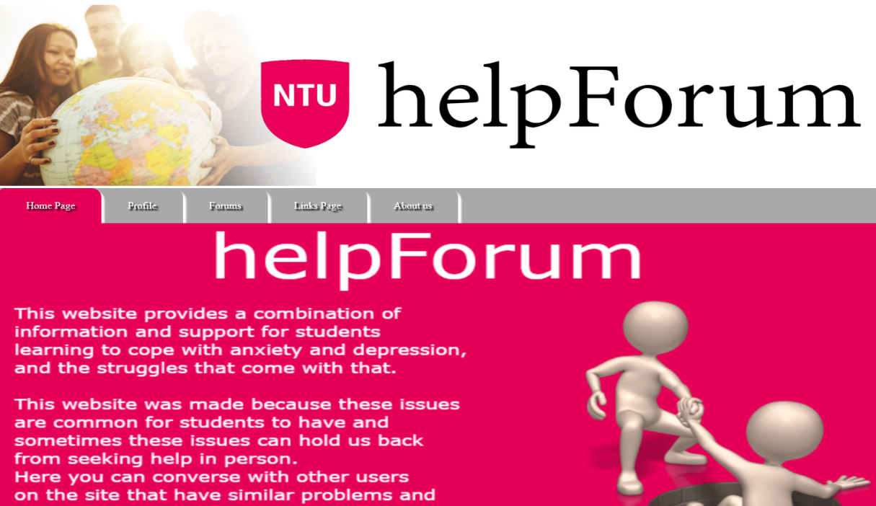
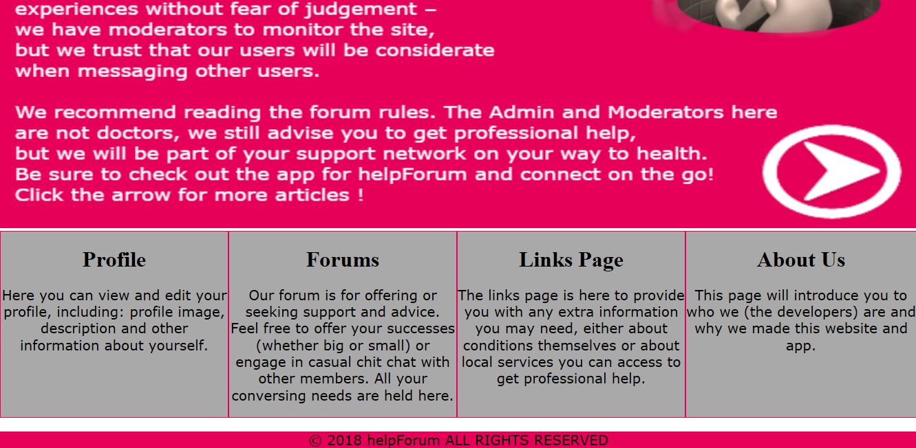
What is the helpForum
helpForum is a web and android application for
University students suffering from Anxiety and Depression.
Creates a sense of Community for the population of students that are battling these issues whilst studying
Provides support and easy to reach platform provided for the university’s student services
Its not a replacement for professional medical help and it is not a replacement for the university’s student services.

Slide 3

helpForum Goals and Objective
To lessen the stigma around seeking for help with mental health issues within university students through the use of the helpForum.
Giving a user-friendly platform for University students to gain support from a community
To give students quick access to links of various services the University’s student services provide.

Slide 4

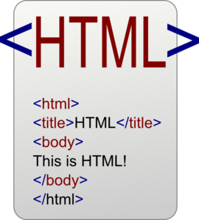




Design
For the design of the website, the decision of inheriting
Nottingham Trent University’s style for their website.
For the front-end design of the website HTML, CSS and ASP are being used to create the client side interface.
As for the android application Java and XML are used for the GUI.

Slide 5


Database
SQL and C# are used to pull the data from the database to manipulate it on the webpage depending on what is required.

Slide 6
Where the project is at
Website
Completed
Coherent Layout
Visually Appealing
Database connected
Users can sign in/Register
Users can view posts from other users
Needs be done
Responsive Design
Copyright images
Format the posts and comments to resemble that of a forum
Add a About Us Page
Add a master page instead of the same CSS file
Ensure the user can add posts
Application
Completed
Posts can be added
Users can view posts from other users
Users can sign in/Register
Database consistent with the websites
Needs to be done
Coherent interface with the website

